Slide 1



DATAMANAGEMENT
PROJECT
By Andrea Nardocci - 1709323

Slide 2

TABLE OF CONTENTS
1
2
3
4
5
6
7
Introduction
Algorithm implementation
Concurrency Control via timestamp
Deadlock management
GUI implementation
Test and Results
Extra features

Slide 3

INTRODUCTION
Software that emulates a scheduler based on a concurrency control via timestamp
Requirements

Slide 4






ALGORITHM IMPLEMENTATION
INIT VARIABLE
PROCESS THE INPUT
IMPLEMENTATION OF THE STRATEGY
DEADLOCK MANAGEMENT

Slide 5
CONCURRENCY CONTROL VIA TIMESTAMP
PROPERTIES : DATA FOR RESOURCES
Associated variable for each resource
rts(X)
wts(X)
wts-c(X)
cb(X) (commit-bit)

Slide 6

CONCURRENCY CONTROL VIA TIMESTAMP
PROPERTIES : RULES
1
2
3
4
5
Read Ok
Read too late
Write ok
Thomas rule
Write too late

Slide 7

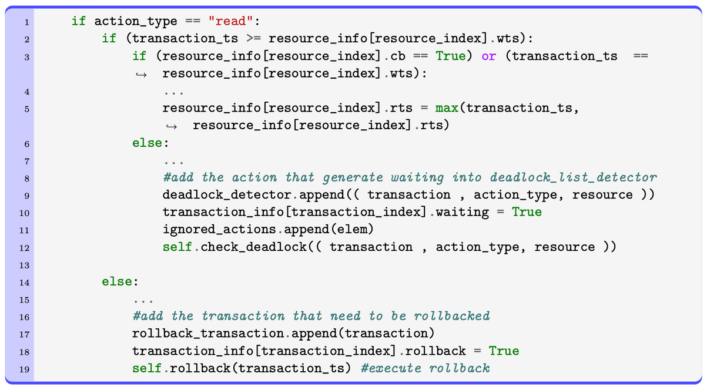



READ EXECUTION
READ EXEC
READ ERROR
The read action changes only. a single parameter , rts(X)
It generate waiting or rollback

Slide 8
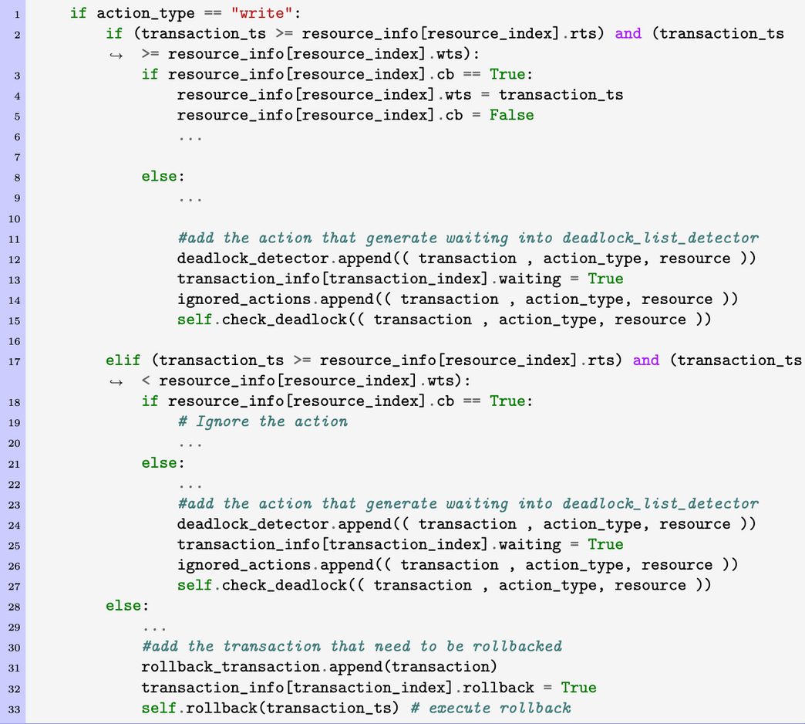
WRITE EXECUTION
WRITE EXEC
WRITE ERROR
The write action changes cb(X) and wts.
It generate waiting or rollback, and also we need to check whether we enter in the Thomas Rule

Slide 9
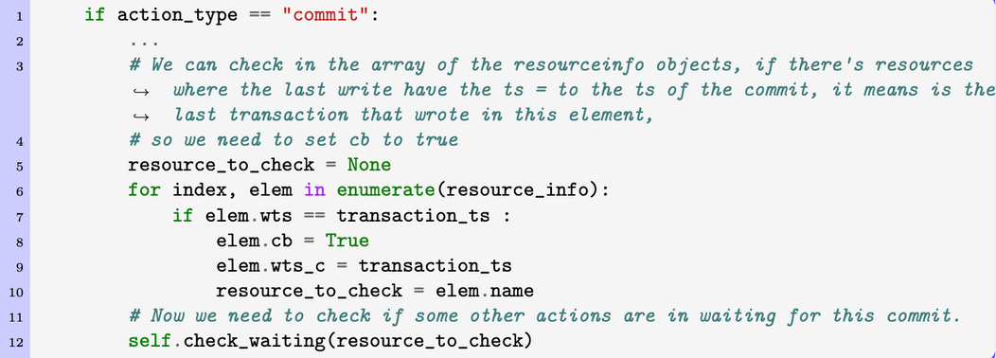
COMMIT EXECUTION
COMMIT EXEC
COMMIT RESULT
The commit action changes the commit bit cb(X) and also the wts_c(X)
We need to check if there’re other transaction that are in waiting for the changes of the commit-bit to True.

Slide 10
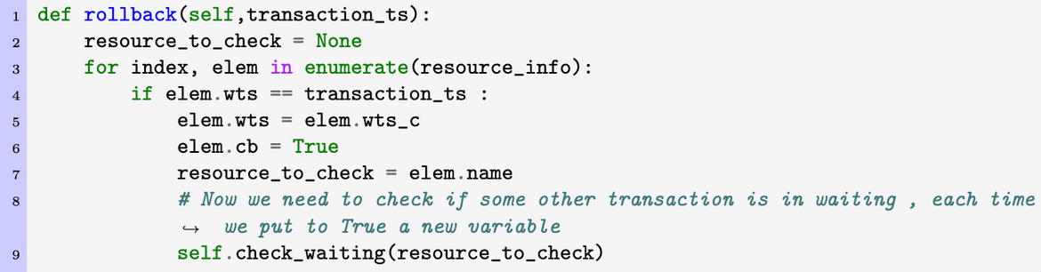
ROLLBACK EXECUTION
ROLLBACK EXEC
ROLLBACK RESULTS
Rollback action, puts wts(X) = wts_c(X) , and change the commit-bit. if the last transaction that wrote X is the one being rolledback.
We need to check if there’re other transaction that are in waiting for the changes of the commit-bit to True.

Slide 11
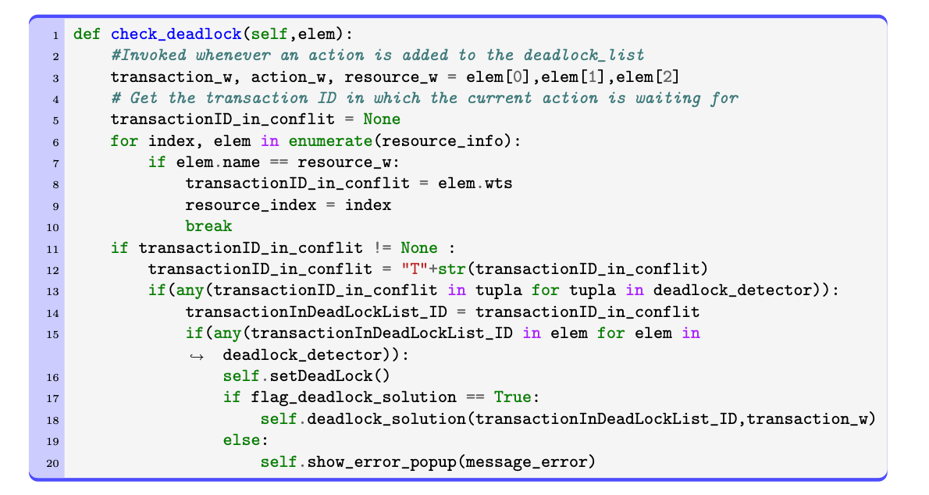
DEADLOCK MANAGEMENT
Deadlock Event
DeadLock Recognition
Deadlock Solution

Slide 12
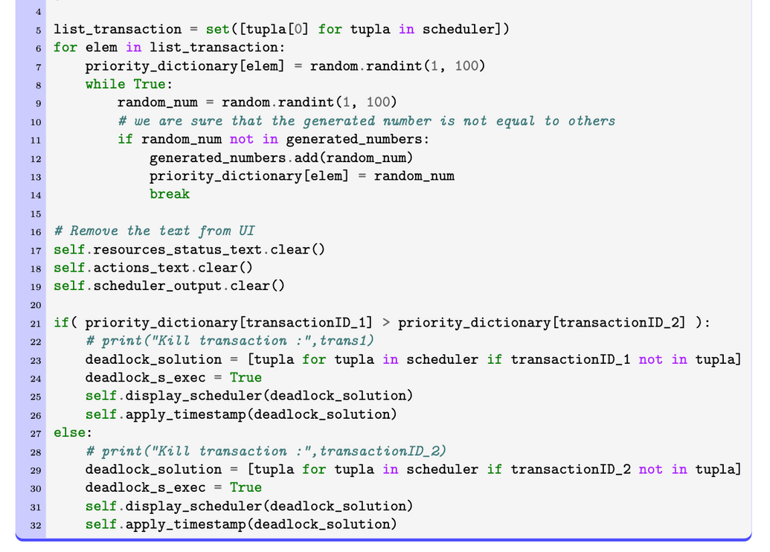
DEADLOCK MANAGEMENT
Deadlock Event
DeadLock Recognition
Deadlock Solution

Slide 13
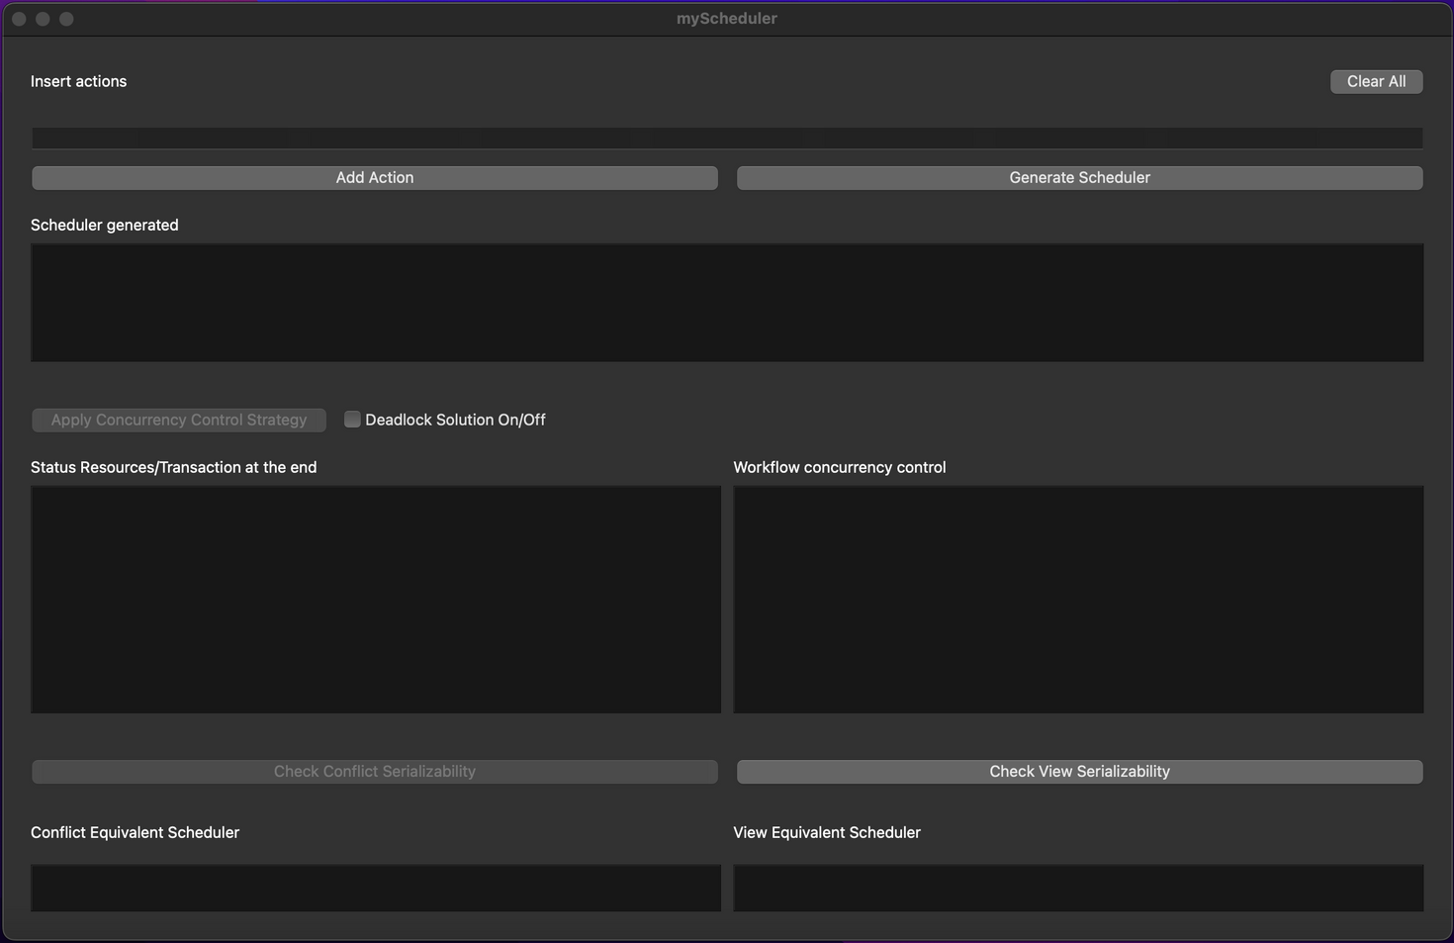

GUI
PyQt6

Slide 14
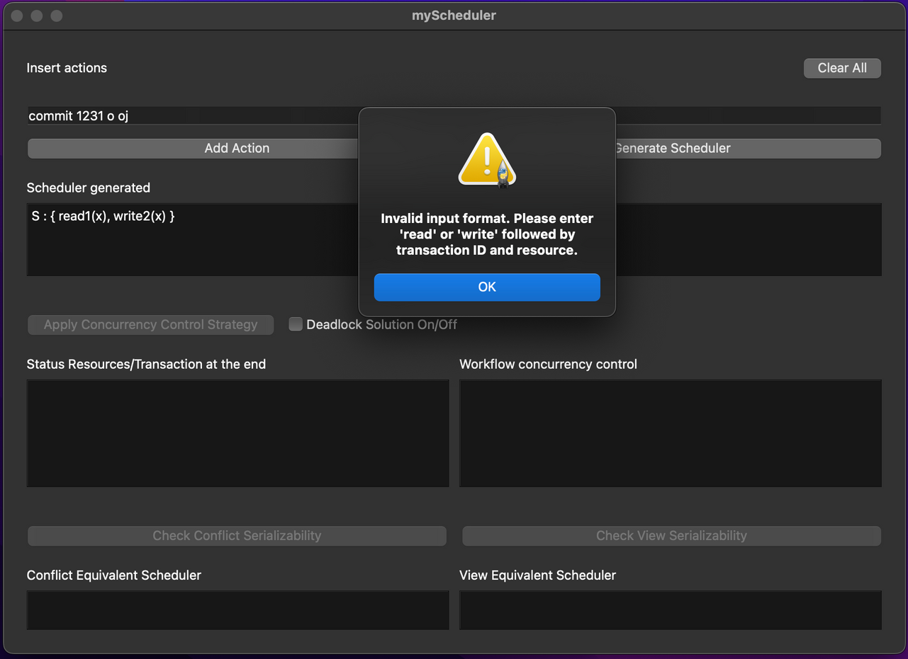
GUI
Input Error Message

Slide 15
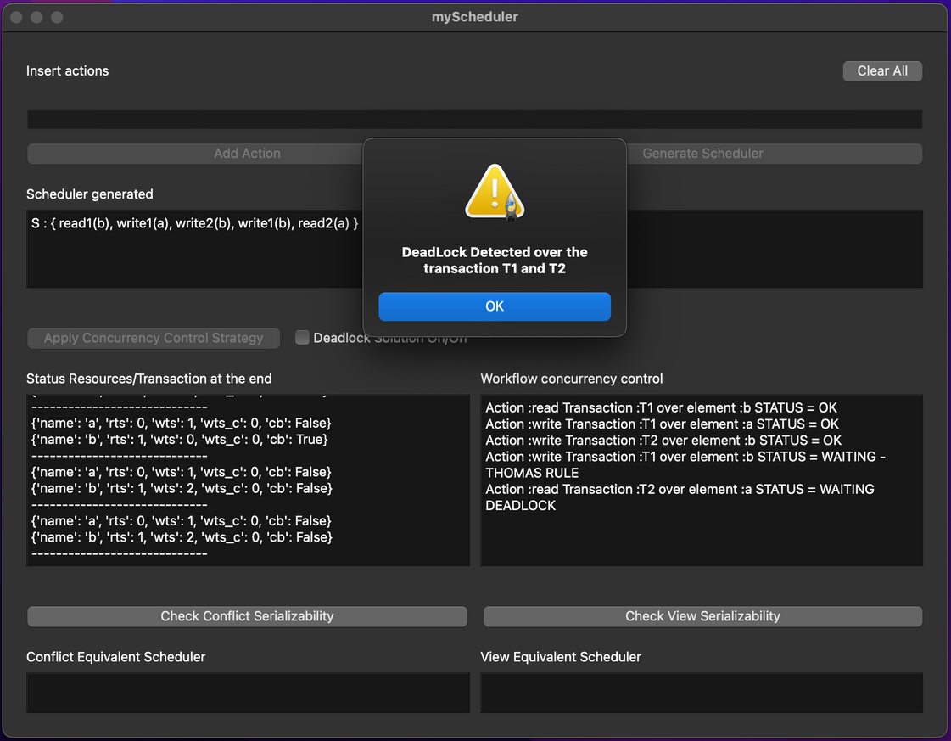
GUI
Deadlock Recognition

Slide 16
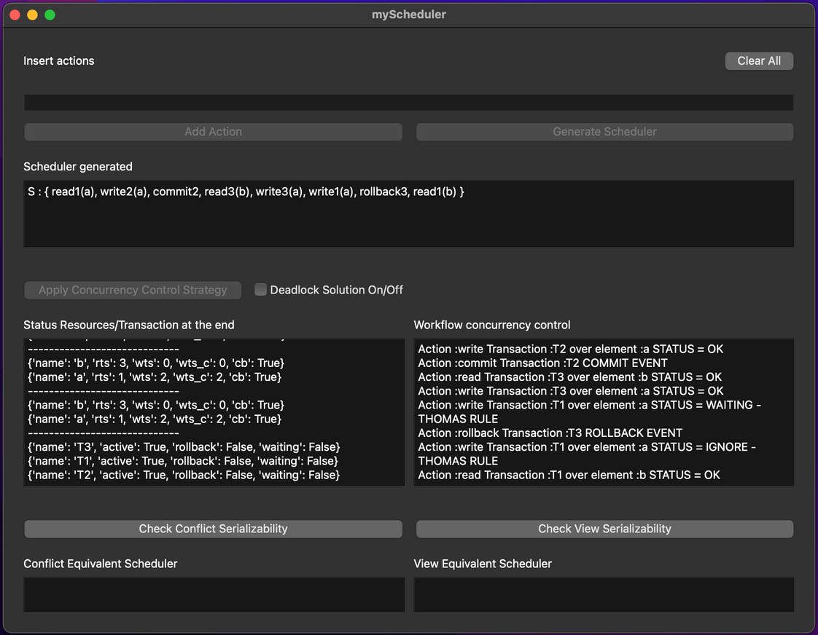
GUI
Concurrency

Slide 17
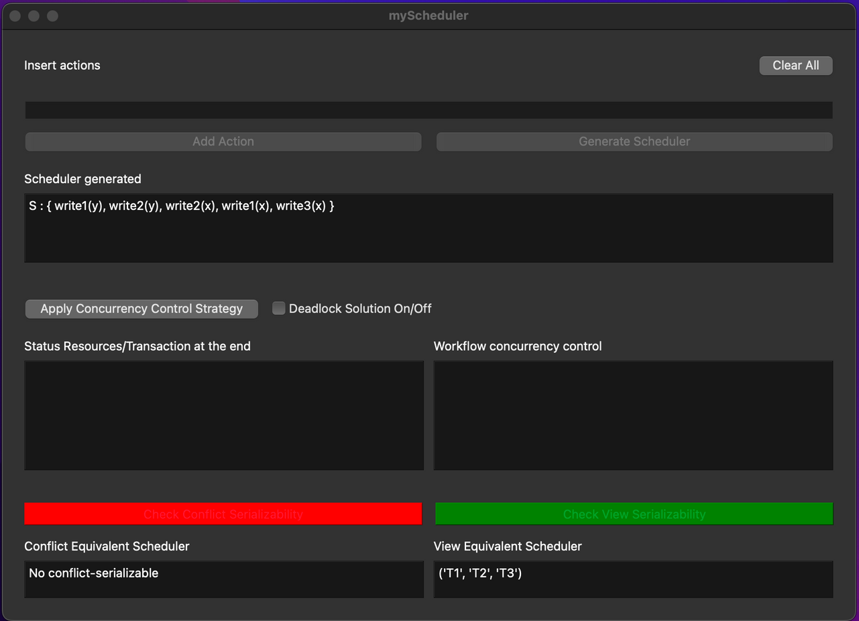
GUI
Extra Features

Slide 18
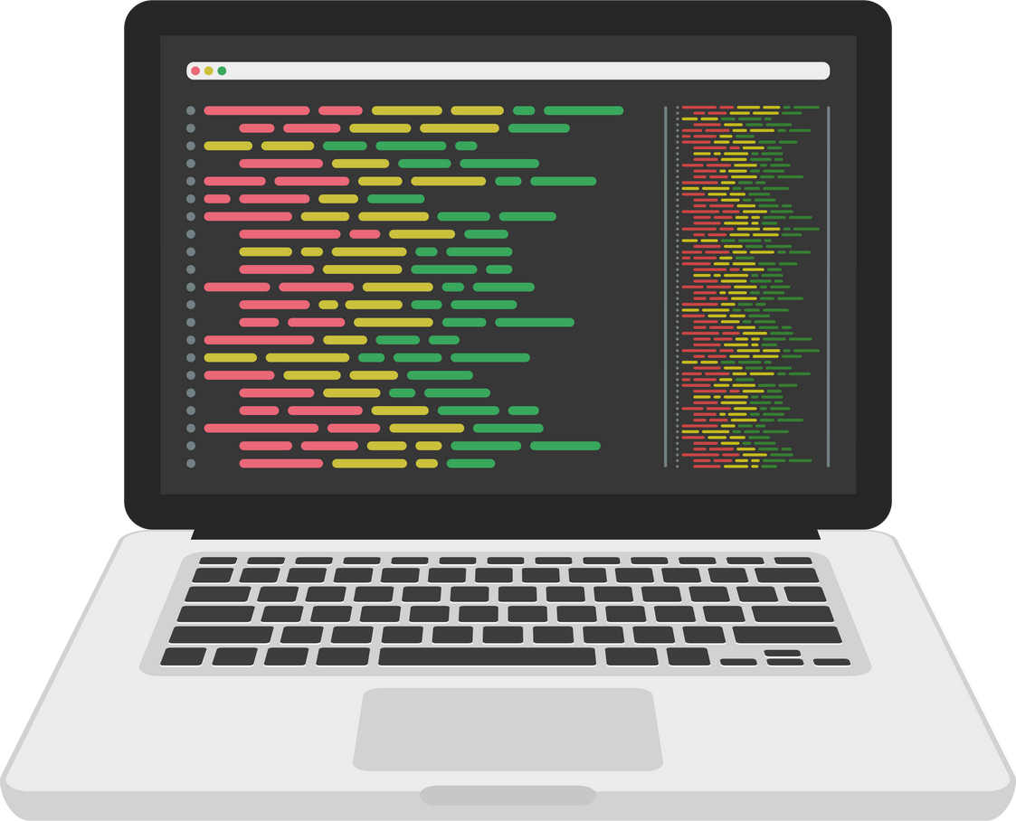

TEST AND RESULTS

Slide 19

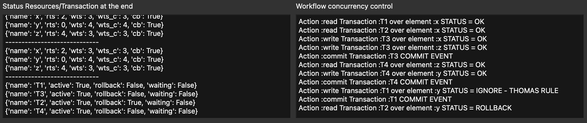

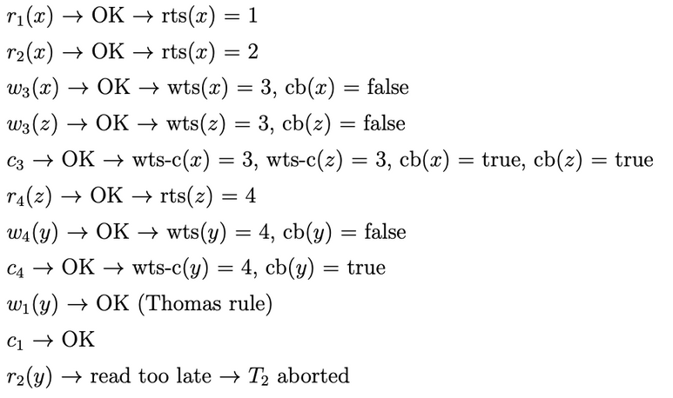
RESULTS AND COMPARISON
SCHEDULER = [ R1(X) R2 (X) W3(X) W3(Z) C3 R4(Z) W4(Y) C4 W1(Y) C1 R2(Y) C2 ]
01
02

Slide 20
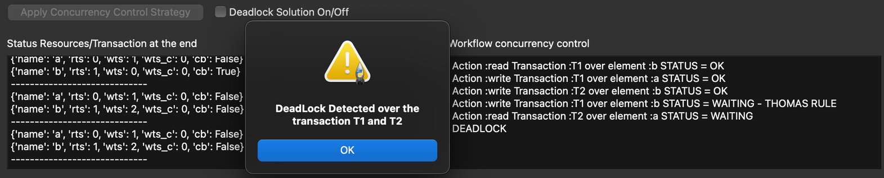
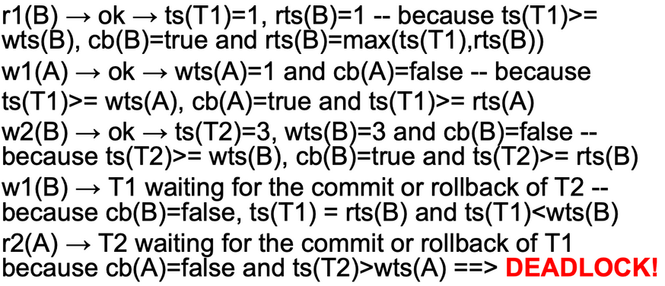
RESULTS AND COMPARISON
SCHEDULER = [ R1(B) W1(A) W2(B) W1(B) R2(A) ]
01
02

Slide 21
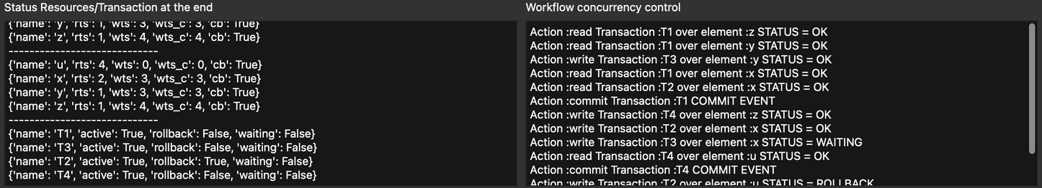
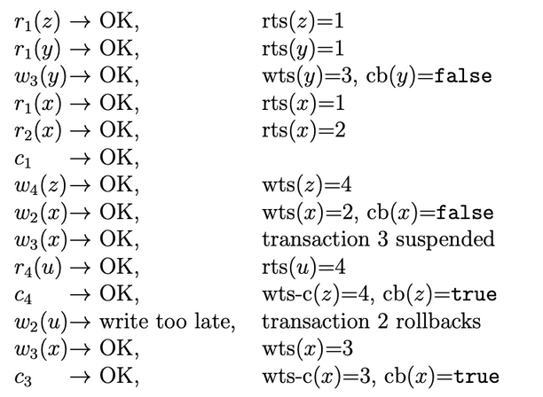
RESULTS AND COMPARISON
SCHEDULER = [ R1(Z) R1(Y) W3(Y) R1(X) R2(X) C1 W4(Z) W2(X) W3(X) C3 R4(U) C4 W2 (U) C2 ]
01
02

Slide 22

THANK YOU!
GitHub Repository

